Slide 1


SAP UI5 & FIORI with OData TRAINING using BAS
Anubhav Oberoy
Day – 7

Slide 2

Agenda – Day 7
Loading Empty view at Start
Performance Issues in our app
Introduction to Router
Routing Configuration
Route Match Handler
Icon Tab Bar
Responsive Table (sap.m.Table)
Performance Issues in our app
Introduction to Router
Routing Configuration
Route Match Handler
Responsive Table (sap.m.Table)
Drill Down using the Table
Messages in UI5
Drop Down
Object Status
Fragments
Different Ways of loading fragment
Value Help Popup

Slide 3
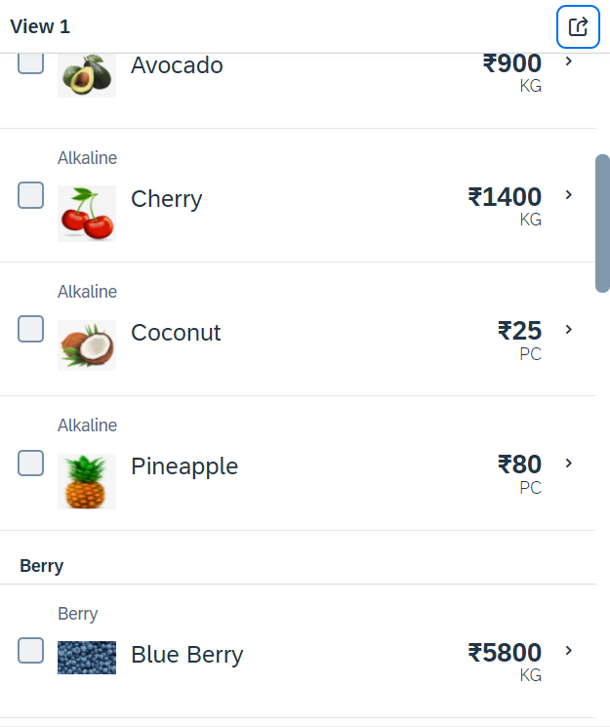
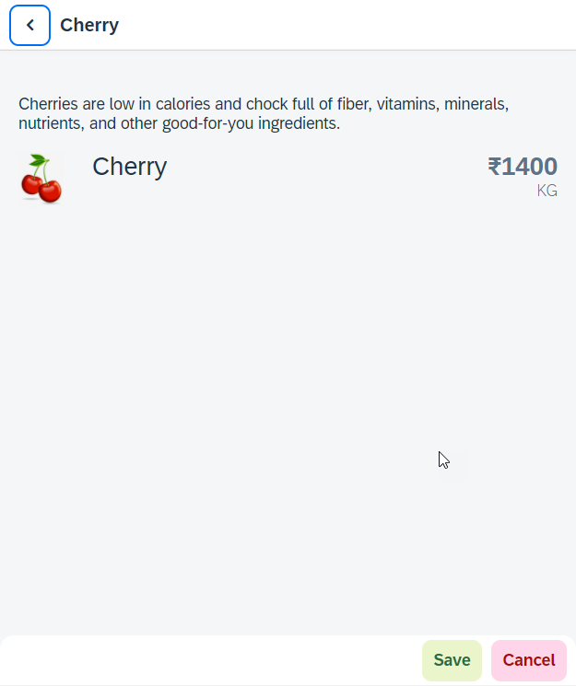
Hands – on: Worklist App
Now we will make our application a worklist app. On selecting the fruit on the View1 navigate to the View2 and show the details of that the selected fruit on it.
For this we have to modify the onSelectItem Function to get the path of the selected item and pass it in the onNext function.
Code Link:
View1.view.xml
View1.controller.js
View2.view.xml

Slide 4
SplitApp Container Control
A split app container control will divide our app into 2 parts, 1st is called master section and 2nd is called detail section. It is used to fully optimize the screen width for desktop apps.
SplitApp Container
masterPages
detailPages
App Container
View1
View2
View1
View2

Slide 5
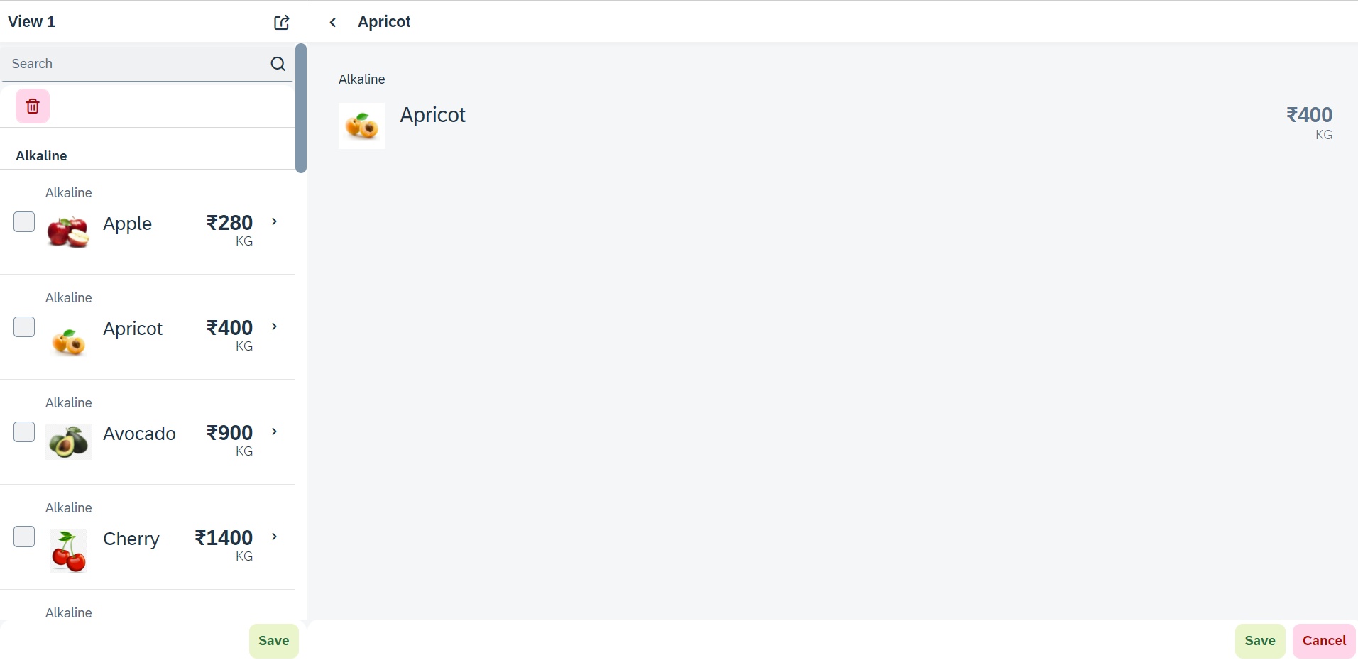
Hands – on: SplitApp (Mater Detail App)
Now we will convert our worklist app to a master detail application.
Once we change the app container, we have to change the method of getting the view object in onNext function.
Code Links:
App.view.xml
Component.js
View1.controller.js

Slide 6
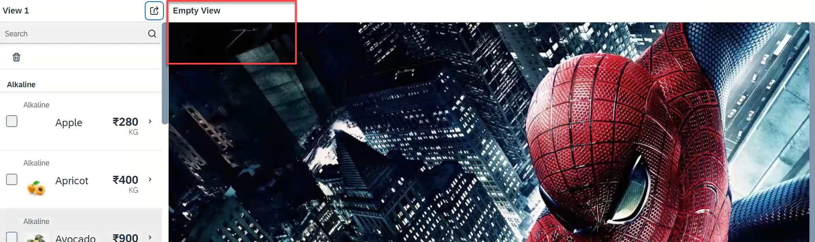
Hands – on: Empty View at start
Now we want to load an Empty view in the detail section when our application starts.
To do this first we need to create one Empty View and Empty controller.
After we need to add the Empty view to the Split App container in the Component.js file.
oAppCon.addMasterPage(oView1).addDetailPage(oEmpty).addDetailPage(oView2);
Code Link:
Empty.view.xml
Empty.controller.js
Component.js
View1.controller.js
This view will be loaded by default

Slide 7
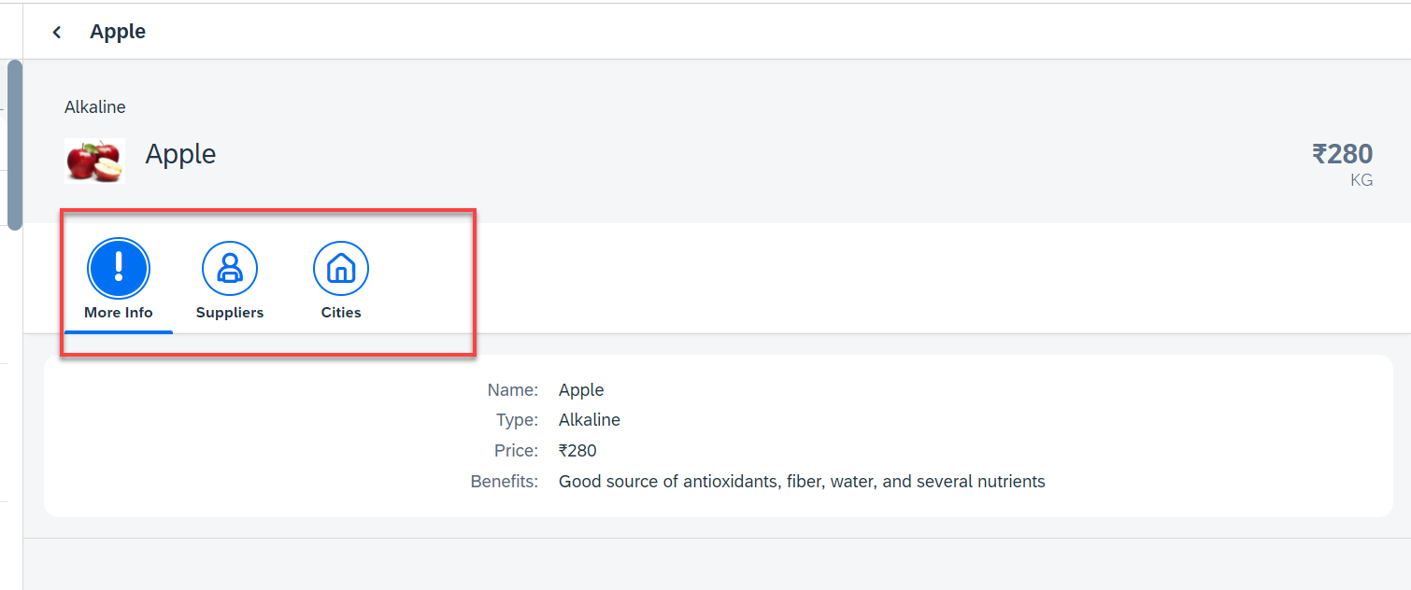
Hands – on: Icon Tab Bar
Now in the View2, we will create a icon tab bar to show the additional data related to the fruits, like Supplier and City data.
For now in the first section we will add a simple form to show the data of fruit.
Code Link:
View2.view.xml

Slide 8
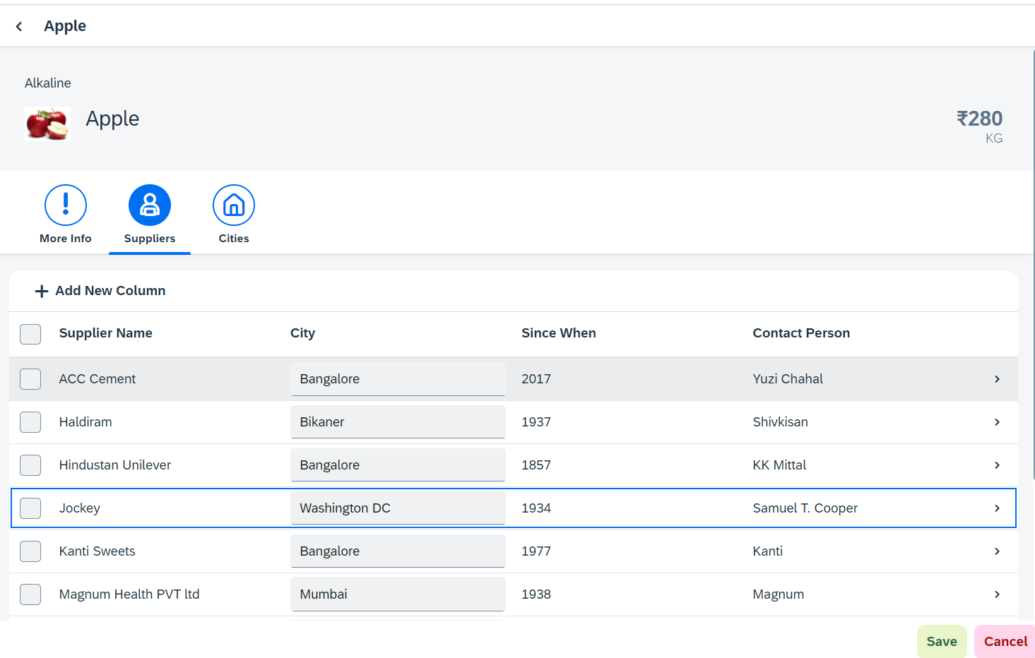
Hands – on: Sap.m.Table (Responsive Table)
Now in the second section of the icon tab filter bar we will add a Responsive table containing the Supplier Data.
Along with that we will add a button in the Header of the table to add a new column.
And on select of a row in the table the table path will be shown in alert message.
Code Link:-
View2.view.xml
View2.controller.js

Slide 9

Performance Issues in our Fiori App
We have used sap.ui.view API to create the object of the view, but it seems that the API is obsolete. Then what is the right way to instantiate our view?
All the view objects are instantiated when app starts, whether we want or not. If user does not navigate to a view, still the view object is getting created. This is a misuse of computation power and slow down our app when number of views are increased/high.
For each view, we are writing more and more code to create object, multiple developers will add this code in different place, because of this the maintenance will be come very expensive even the handover will be very hard.
The browser navigation button (back) is not working properly.
When the refresh of app happens, the application should restore the state of the UI. It should not start all over again. So user will not frustrate applying all the filters again.
When we take a URL of the page and share with colleagues/friends/family, when they open same URL, Eventually they should see the same state of application what I see. Basically we should restore the state of UI as it is in our system.
Router

Slide 10
Router
Router is an object which is provided by SAP UI5 Component (UIComponent).
It is responsible for creating our view objects on demand.
It is also responsible for complete app navigation based on pattern (end point, hash tag).
How to use router:
Get the router object form the UIComponent class.
Call initialize method using the object
The initialize method will SCAN manifest.json to find the routing configuration (mandatory).
Add the routing configuration in manifest.json
rootView – base view we want to load
config – base configuration like view type, path of all views etc.
routes – array of all the targets, patterns and route names
targets – put all the end point target with views which needs to be instantiated and nav.
Sap.m.routing.Router is the class used for Routing and Navigation purpose in SAP UI5 framework.
“Pattern” defines the hashtag that needs to be added at the end of the URL when it is hit.
“name” defines a unique name for the particular route.
“target” defines the target which is defined in targets section

Slide 11
Routing Configuration
Routing Configuration is defined in manifest.json file. It is defined under the “sap.ui5” section.
Routing configuration consists of routes, targets, config, and owner.
rootView
config
routes
targets
This section contains the information about our Root View. The View which works as a container for other views. In this section we provide the path of the view, type and controlId.
This section contains the global router configuration and default values that apply for all routes and targets. We define the router class that we want to use and where our views are located in the app.
Each route defines a name, a pattern, and one or more targets to navigate to when the route has been hit.
Three subsections :-
1. pattern
2. name
3. target
A target defines a view that is or more routes displayed, it is associated with one.
Subsections: -
Overview
detail

Slide 12
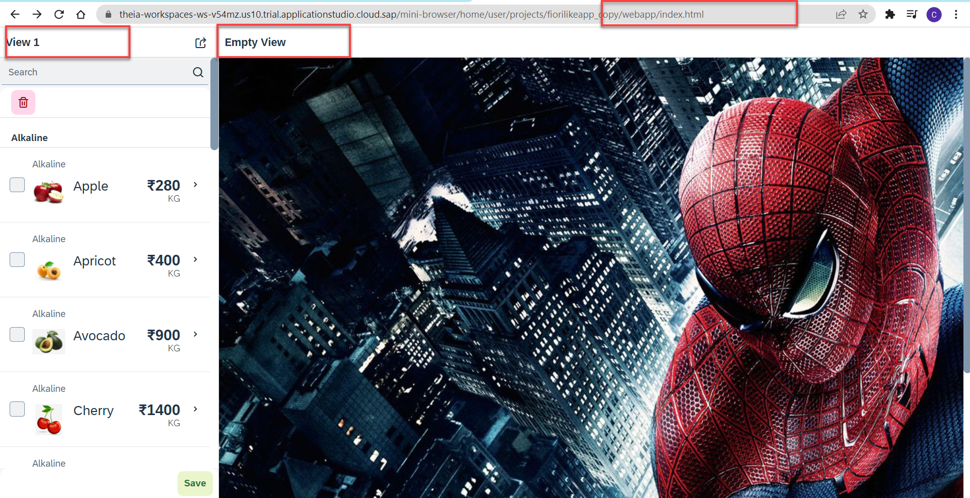
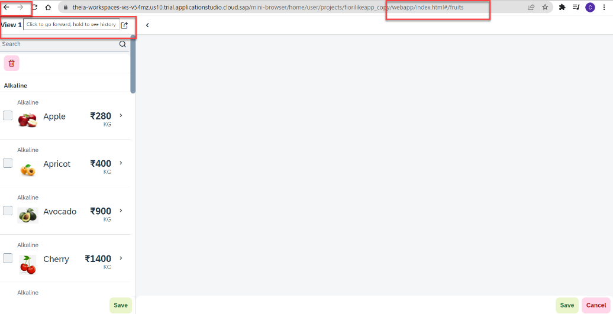
Hands – on: Routing Implementation
Now we need to implement routing in our existing application, for that we have to follow the Steps provided in the previous slides.
We also have to change the navigation in our View1 controller, and make it according to the Router, for that we have to get the router object in the View1 controller and then navigate to the view using the navTo() function.
To get the router object in View1 controller
this.oRouter = this.getOwnerComponent().getRouter();
To navigate to the View2
this.oRouter.navTo("loadMyV2");
Code Links:
manifest.json
Component.js
View1.controller.js

Slide 13
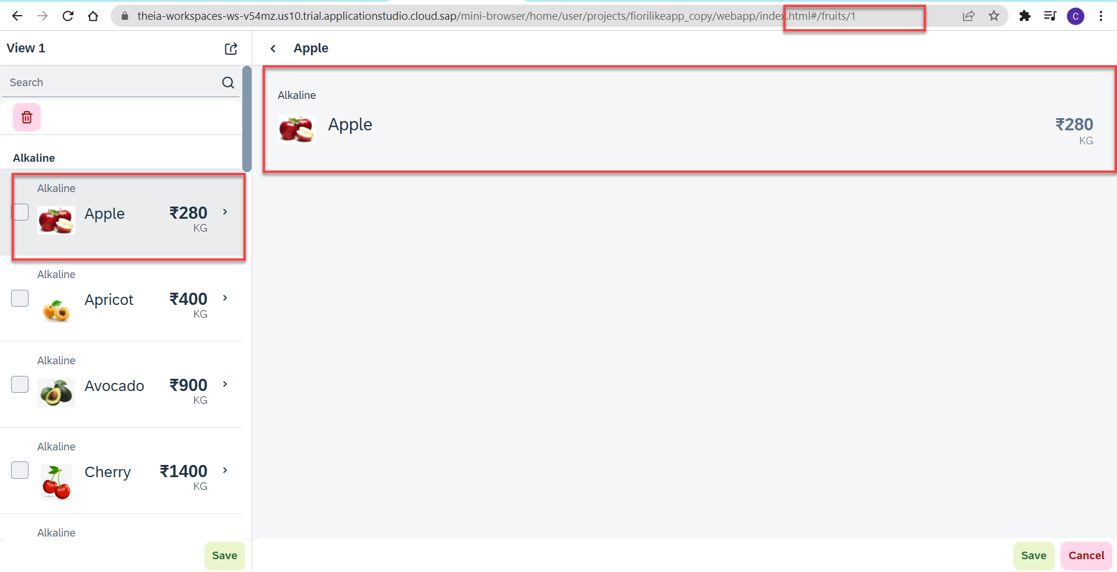
Hands – no: Route Match Handler
Route Match Handler: It is a function which gets triggered every time when Route, End Point, Hash Tag Changes.
Now using the route match handler we will load the data of the selected fruit.
Code Link:-
View1.controller.js
View2.controller.js
manifest.js

Slide 14
Performance Issues in our Fiori App
We have used sap.ui.view API to create the object of the view, but it seems that the API is obsolete. Then what is the right way to instantiate our view?
All the view objects are instantiated when app starts, whether we want or not. If user does not navigate to a view, still the view object is getting created. This is a misuse of computation power and slow down our app when number of views are increased/high.
For each view, we are writing more and more code to create object, multiple developers will add this code in different place, because of this the maintenance will be come very expensive even the handover will be very hard.
The browser navigation button (back) is not working properly.
When the refresh of app happens, the application should restore the state of the UI. It should not start all over again. So user will not frustrate applying all the filters again.
When we take a URL of the page and share with colleagues/friends/family, when they open same URL, Eventually they should see the same state of application what I see. Basically we should restore the state of UI as it is in our system.
Router

Slide 15
Router
Router is an object which is provided by SAP UI5 Component (UIComponent).
It is responsible for creating our view objects on demand.
It is also responsible for complete app navigation based on pattern (end point, hash tag).
How to use router:
Get the router object form the UIComponent class.
Call initialize method using the object
The initialize method will SCAN manifest.json to find the routing configuration (mandatory).
Add the routing configuration in manifest.json
rootView – base view we want to load
config – base configuration like view type, path of all views etc.
routes – array of all the targets, patterns and route names
targets – put all the end point target with views which needs to be instantiated and nav.
Sap.m.routing.Router is the class used for Routing and Navigation purpose in SAP UI5 framework.
“Pattern” defines the hashtag that needs to be added at the end of the URL when it is hit.
“name” defines a unique name for the particular route.
“target” defines the target which is defined in targets section

Slide 16
Routing Configuration
Routing Configuration is defined in manifest.json file. It is defined under the “sap.ui5” section.
Routing configuration consists of routes, targets, config, and owner.
rootView
config
routes
targets
This section contains the information about our Root View. The View which works as a container for other views. In this section we provide the path of the view, type and controlId.
This section contains the global router configuration and default values that apply for all routes and targets. We define the router class that we want to use and where our views are located in the app.
Each route defines a name, a pattern, and one or more targets to navigate to when the route has been hit.
Three subsections :-
1. pattern
2. name
3. target
A target defines a view that is or more routes displayed, it is associated with one.
Subsections: -
Overview
detail

Slide 17
Hands – on: Routing Implementation
Now we need to implement routing in our existing application, for that we have to follow the Steps provided in the previous slides.
We also have to change the navigation in our View1 controller, and make it according to the Router, for that we have to get the router object in the View1 controller and then navigate to the view using the navTo() function.
To get the router object in View1 controller
this.oRouter = this.getOwnerComponent().getRouter();
To navigate to the View2
this.oRouter.navTo("loadMyV2");
Code Links:
manifest.json
Component.js
View1.controller.js

Slide 18
Hands – no: Route Match Handler
Route Match Handler: It is a function which gets triggered every time when Route, End Point, Hash Tag Changes.
Now using the route match handler we will load the data of the selected fruit.
Code Link:-
View1.controller.js
View2.controller.js
manifest.js

Slide 19
Hands – on: Sap.m.Table (Responsive Table)
Now in the second section of the icon tab filter bar we will add a Responsive table containing the Supplier Data.
Along with that we will add a button in the Header of the table to add a new column.
And on select of a row in the table the table path will be shown in alert message.
Code Link:-
View2.view.xml
View2.controller.js

Slide 20
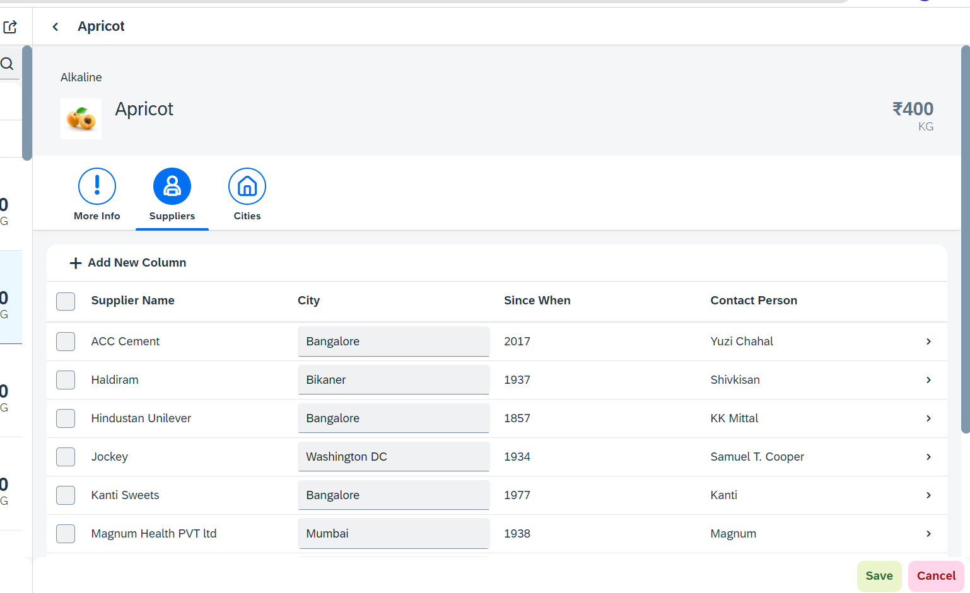
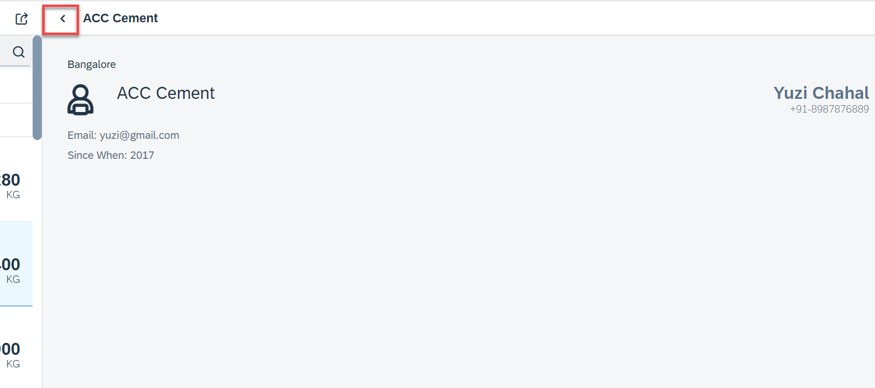
Hands – on: Drill Down from Table and Nav Back
Now we drill down to a new screen where we will show the supplier data for that we will create a new supplier view.
Along with that we will also add the back button login to go back using a nav button on the supplier view.
Code Link:-
View2.controller.js
Supplier.view.xml
Supplier.controller.js
BaseController.js
manifest.js
The nav back logic is written in BaseController so that it can be used at multiple places.

Slide 21
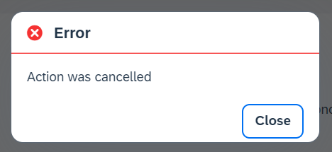
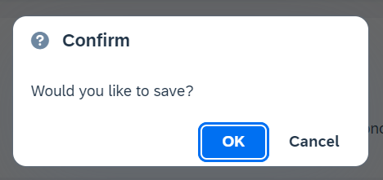
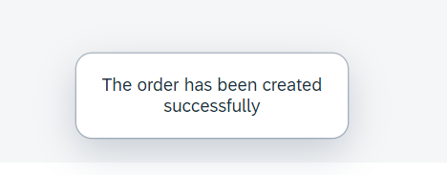
Messages in UI5
The system generates messages in response to what users do in the SAP system. A message presents information, an instruction, or a warning to users in a given situation.
Messages can be used to notify the user about specific states of the application and can help the user to correct their incorrect inputs.
For showing messages to the user that are related to the current page, you have several possible controls. Each of these offers a different type of interaction from the user. Choose the control that fits best in you interaction pattern.
Message Dialog: A message dialog interrupts the user's workflow by blocking the current page and needs to be closed by the user.
Message Toast: A message toast is an overlay that disappears after some time or if the user taps somewhere else. It does not block the user.
Message Box of type error
Message Box of type Confirm
Message Toast

Slide 22
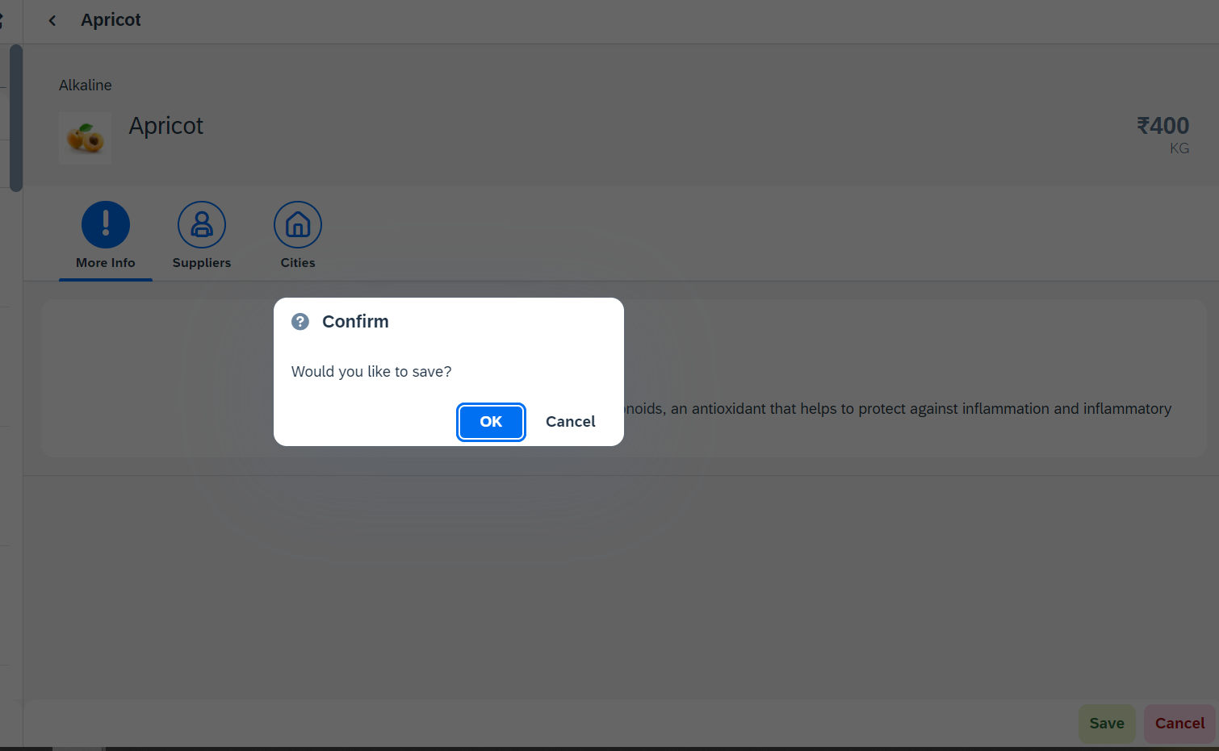
Hands – on: Messages
Now we will see how to use the messages in the ui to get users conformation or to show error to the use.
For this we will see the example of Message Box and Message Toast.
Code Link: -
View2.view.xml
View2.controller.js

Slide 23
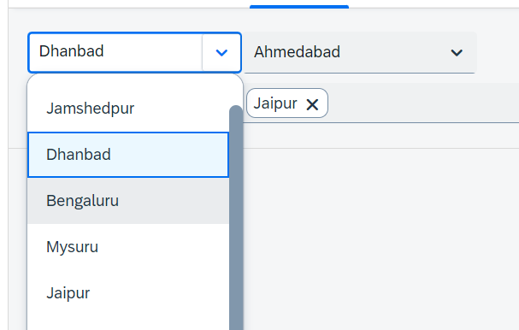
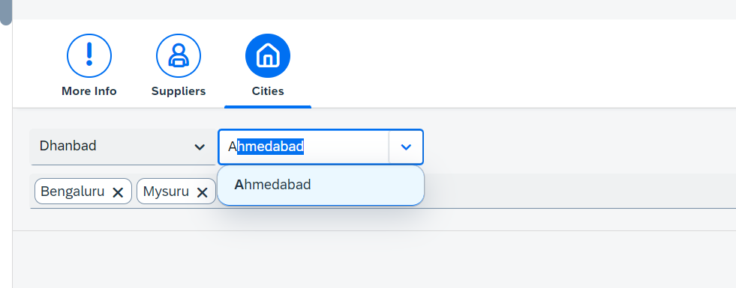
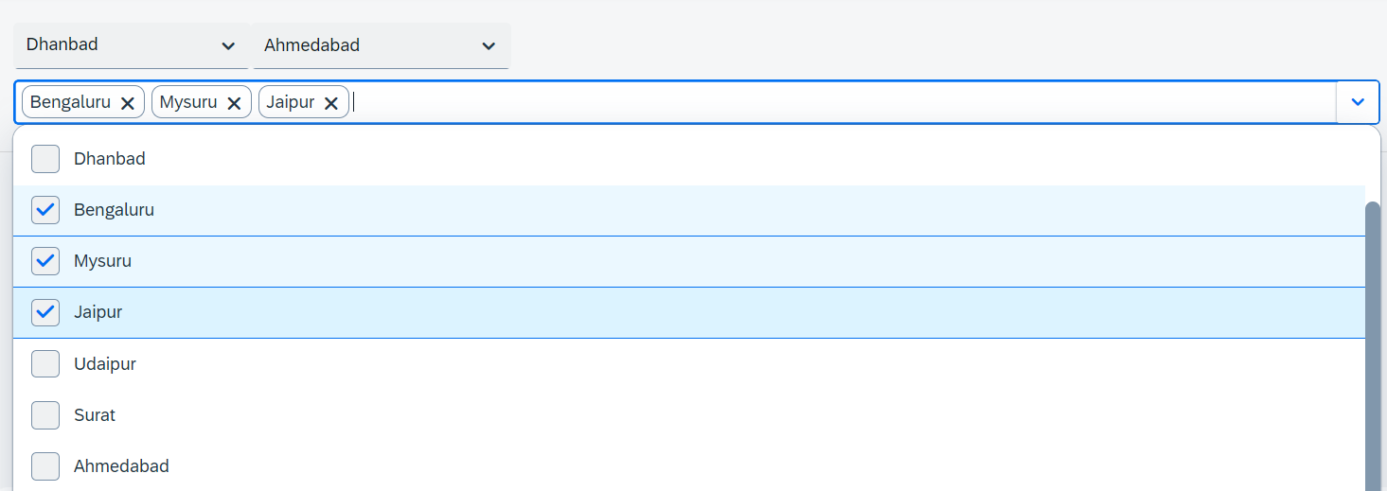
Hands – on: Drop Down Controls
Now we will see the example of some Drop Down Controls present in UI5.
We will load the cities data in the different types of drop downs to see their functioning.
Code Link:-
View2.view.xml

Slide 24
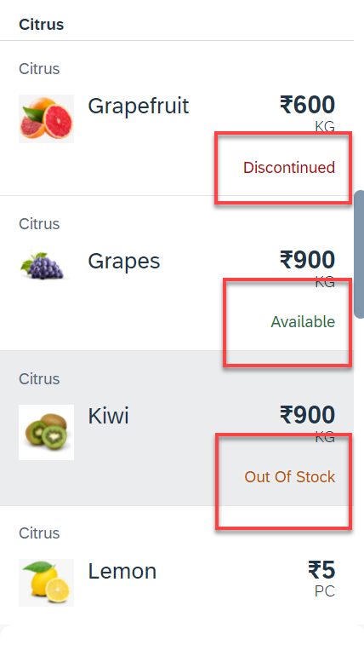
Hands – on: Object Status
Some time we want to show the status any item in different colors, as in our case we want to show the availability of a fruit in different colors like Available, Out of Stock, Discontinued.
For this we will add the object status attribute in the Object list item in View1.
Code Link:-
View1.view.xml
View1.controller.js
formatter.js

Slide 25
Fragments
Fragments are light-weight UI parts. They are used to modularize views. We can reuse a fragment multiple times in same view or other views.
Fragments are used similar as sap.ui.core.mvc.Views, but Fragments do not have their own controllers. Logic related to fragment’s UI elements is written in the host view’s controller.
Fragments are like parasite, they rely on the controllers of the host views.
There are 2 techniques to create and work with fragments
Direct embedding using fragment
Use JS class sap/ui/core/Fragment and use load function to load it
View1
Controller1
Address – street, house, city, country
fragment
B
Event for fragment button
fragment
B
View 2
Controller2
fragment
Event for fragment button
B

Slide 26
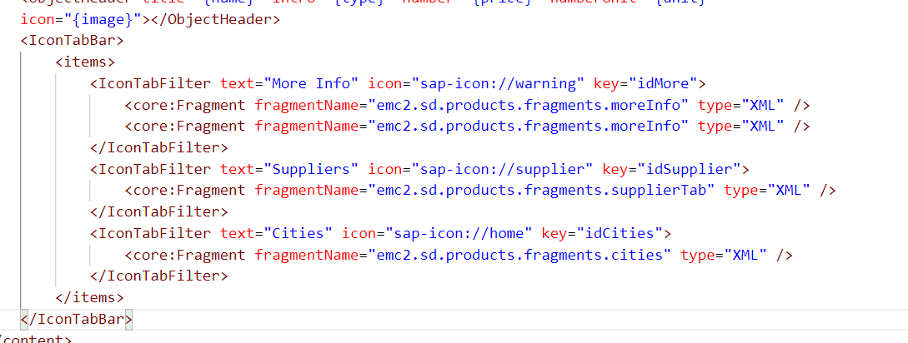
Hands – on: Embedding Fragment in View
For this hands – on we have to create a folder named fragments in the webapp folder and in that folder create fragment files with the extension .fragment.xml.
We will move the Icon Tab bar code to the fragments and will embed them in the View2 to modularize the code of View2.
Create three file in the fragments folder for more Info Section, Supplier Table section and Cities Section.
To including the fragment directly into the XML View use the sap.ui.core.Fragment class as shown below
Ex: <core:Fragment fragmentName=“namespace.fragments.fragmentName" type="XML" />
Code Links:-
View2.view.xml
moreInfo.fragment.xml
cities.fragment.xml
supplierTab.fragment.xml

Slide 27
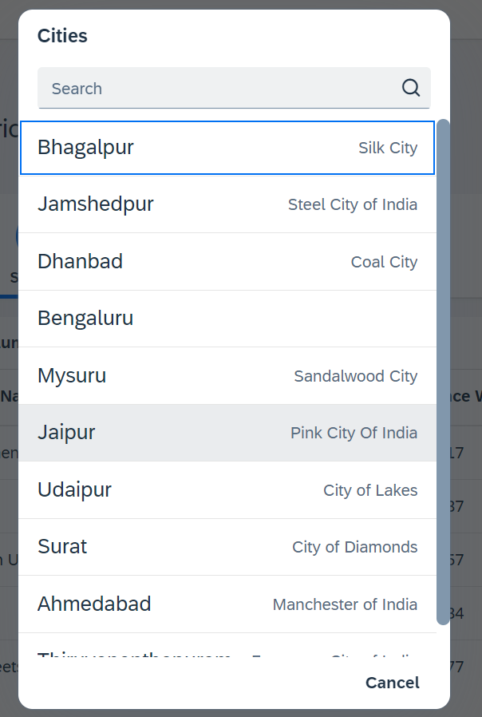
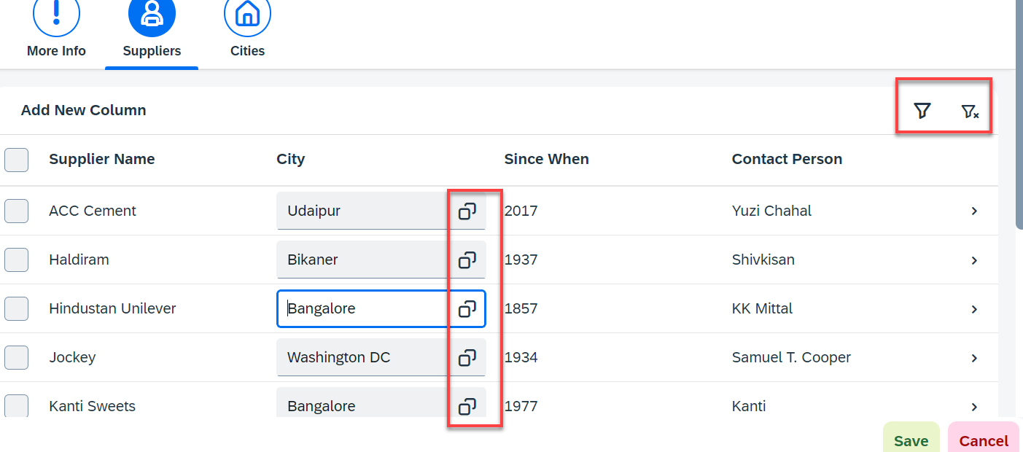
Hands – on: Fragment Use Case 2 (Using JS Code)
My manager asked me to develop following requirements
Add a filter button in the toolbar of the table, and when we click filter icon, it should load a popup with all the list of suppliers. When we select supplier inside filter it should filter data in the table.
Inside the table we have a city field. We would like to enable a value help (F4 Help), when we click on same, it should open a popup which shows all the list of cities on screen.
Part 1: Opening filter popup using the Filter Button.
popup.fragment.xml
supplierTab.fragment.xml
View2.controller.js
Part 2: Opening the Value help popup in the Supplier Table
popup.fragment.xml
supplierTab.fragment.xml
View2.controller.js

Slide 28

End of Day 7

Slide 29

Questions

Slide 30

Anubhav Oberoy

Slide 31


We’re committed to empower you to be
Most Desirable Resource
through powerful training solutions.
We build the workforce of the future.
250+
Corporate Clients
30,000+
Learners Trained
25000+
Learners Placed
FREE WEBINARS
Sign up for free webinars with industry experts every fortnight!
Enroll Now!
Contact us today!
https://anubhavtrainings.com/

Slide 32




More from AnubhavTrainings.com

Slide 33
Title
Content

